Slide 1

Chapter 4:
Making Decisions

Slide 2
4.5
Nested if Statements

Slide 3

Nested if Statements
An if statement that is nested inside another if statement
Nested if statements can be used to test more than one condition

Slide 4
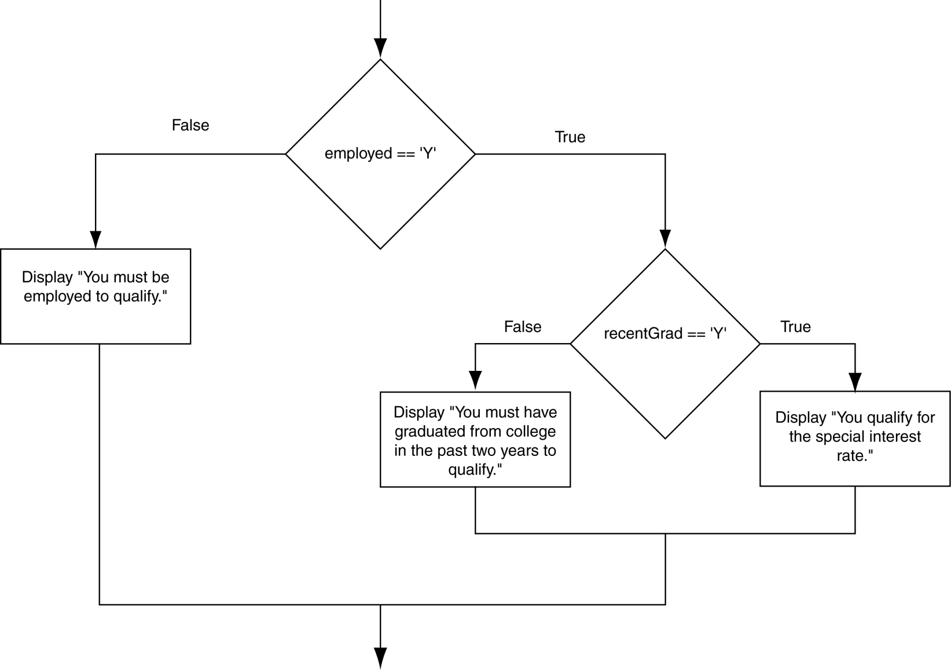
Flowchart for a Nested if Statement

Slide 5
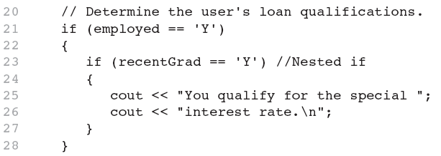
Nested if Statements
From Program 4-10

Slide 6
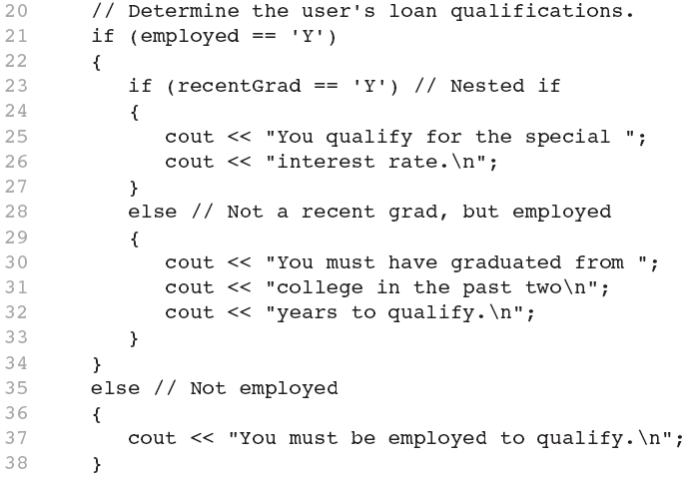
Nested if Statements
Another example, from Program 4-1

Slide 7
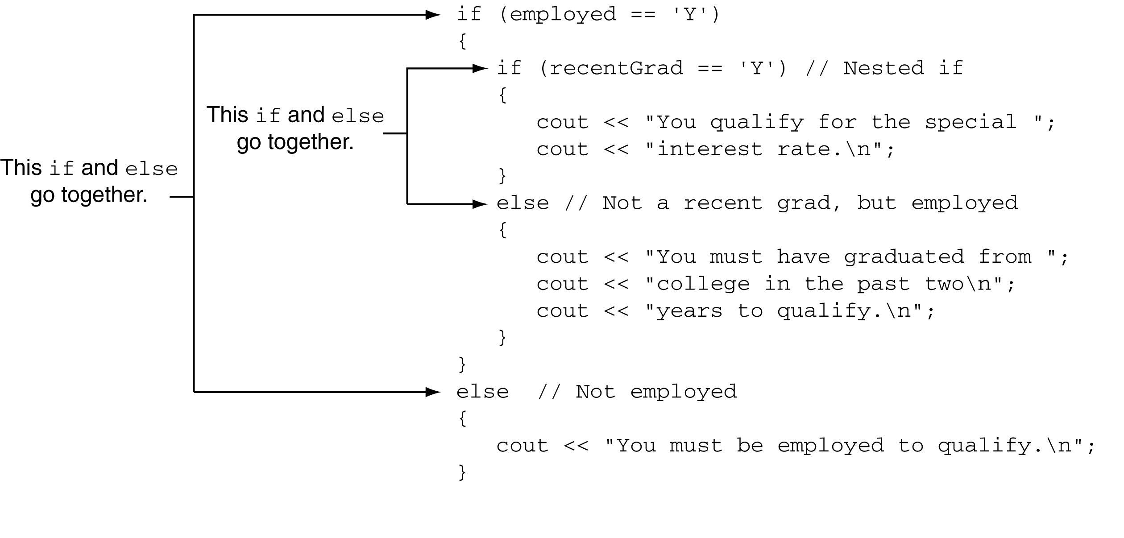
Use Proper Indentation!

Slide 8
4.6
The if/else if Statement

Slide 9
The if/else if Statement
Tests a series of conditions until one is found to be true
Often simpler than using nested if/else statements
Can be used to model thought processes such as:
"If it is raining, take an umbrella,
else, if it is windy, take a hat,
else, take sunglasses”

Slide 10
if/else if Format
  if (expression_1)
  statement1; // or block
  else if (expression_2)
  statement2; // or block
  .
  . // other else ifs .
  else if (expression_n)
  statementn; // or block

Slide 11
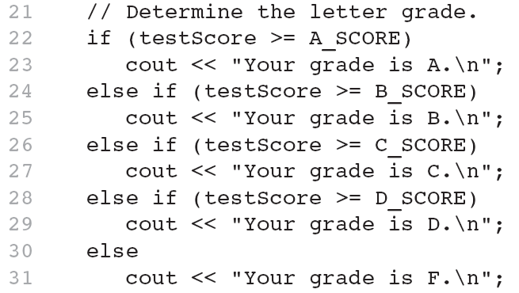
The if/else if Statement in Program 4-13

Slide 12
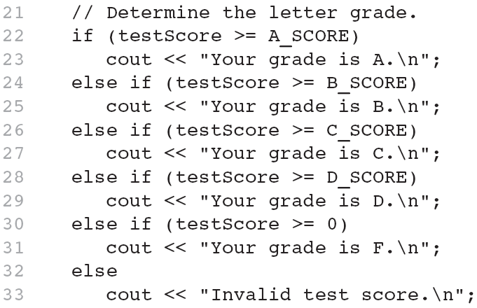
Using a Trailing else to Catch Errors in Program 4-14
The trailing else clause is optional, but it is best used to catch errors.
This trailing else catches invalid test scores

Slide 13
4.7
Flags

Slide 14
Flags
Variable that signals a condition
Usually implemented as a bool variable
Can also be an integer
  The value 0 is considered false
  Any nonzero value is considered true
As with other variables in functions, must be assigned an initial value before it is used

Slide 15
4.8
Logical Operators

Slide 16
Logical Operators
Used to create relational expressions from other relational expressions
Operators, meaning, and explanation:
&& | AND | New relational expression is true if both expressions are true
|| | OR | New relational expression is true if either expression is true
! | NOT | Reverses the value of an expression – true expression becomes false, and false becomes true

Slide 17
Logical Operators-Examples
int x = 12, y = 5, z = -4;
(x > y) && (y > z) | true
(x > y) && (z > y) | false
(x <= z) || (y == z) | false
(x <= z) || (y != z) | true
!(x >= z) | false

Slide 18
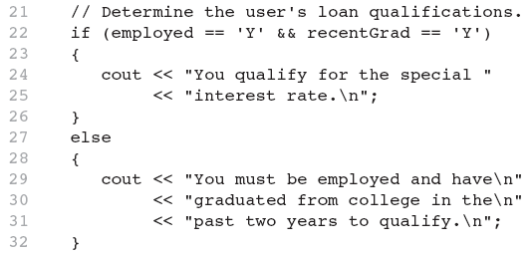
The logical && operator in Program 4-15

Slide 19
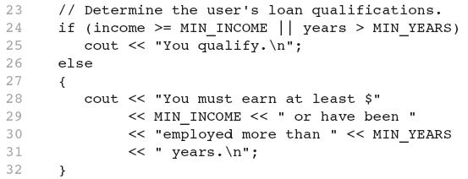
The logical || Operator in Program 4-16

Slide 20
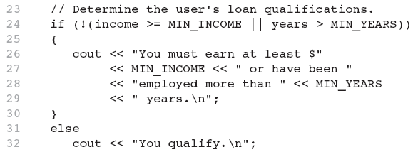
The logical ! Operator in Program 4-17

Slide 21
Logical Operator-Notes
! has highest precedence, followed by &&, then ||
If the value of an expression can be determined by evaluating just the sub-expression on left side of a logical operator, then the sub-expression on the right side will not be evaluated (short circuit evaluation)

